Slide 1
MANAGEMENT LEADERSHIP REPORT
STRATEGIC BUSINESS INSIGHTS FROM NAMMA YATRI RIDE DATA
Submitted By-
1.Shatrughan Patel
2.Surabhi Sharma
3.Shreya Aron

Slide 2
AGENDA
Objective & Scope Enhancing ride efficiency, revenue, and customer satisfaction through data-driven insights.
Key Performance Highlights Demand trends, revenue patterns, zone performance, and payment preferences.
Strategic Insights High-impact time slots, top-performing zones, and user behavior trends, Dashboards.
Recommendations Driver allocation, targeted promotions, and digital payment incentives.
Action Plan & Impact Roadmap for implementation and expected business outcomes.

Slide 3
OBJECTIVE & SCOPE
Objective:
We aim to present high-level insights, performance metrics, and strategic recommendations to enable informed decision-making by business leaders.
Scope:
Enhance customer experience and ride reliability
Maximize revenue and zone profitability
Improve payment efficiency and ride fulfillment rates
Support data-driven decision-making with real-time dashboards
Cancellations & Conversions
Key KPIs & Strategic Recommendations
Demand & Revenue Trends

Slide 4
KEY PERFORMANCE INDICATORS
Analyzed 983 completed trips in Bengaluru
Ride demand peaks in morning (6–10 AM) , Evening (5-6 PM) and late evening (9–11 PM)
Top revenue zones: Bangalore South, Yeshwantpur, Hebbal, Rajarajeshwarinagar, Ramanagaram
76.98% quote-to-completion rate → which can be improved by taking some measures
Digital payments (UPI, cards) dominate; cash usage still notable
Targeted interventions suggested for underperforming zones and time slots

Slide 5
STRATEGIC INSIGHTS
1. Peak Demand & Revenue Window
Highest trip volumes observed at:
Early Morning (6–7 AM)
Late Morning (11 AM–12 PM)
Afternoon (1–2 PM)
Evening (5–6 PM)
Late Night (10–11 PM)
Off-peak hours
(12–6 AM) have lower ride supply despite demand in key zones (e.g., airport rides).
Revenue Insights:
0–1 AM and 10–11 PM deliver the highest per-ride revenue.
Action Point:
Prioritize driver availability during these time slots to maximize ride coverage and reduce cancellation rates.
Introduce surge bonuses or guaranteed fare slabs for drivers operating in low-supply windows

Slide 6
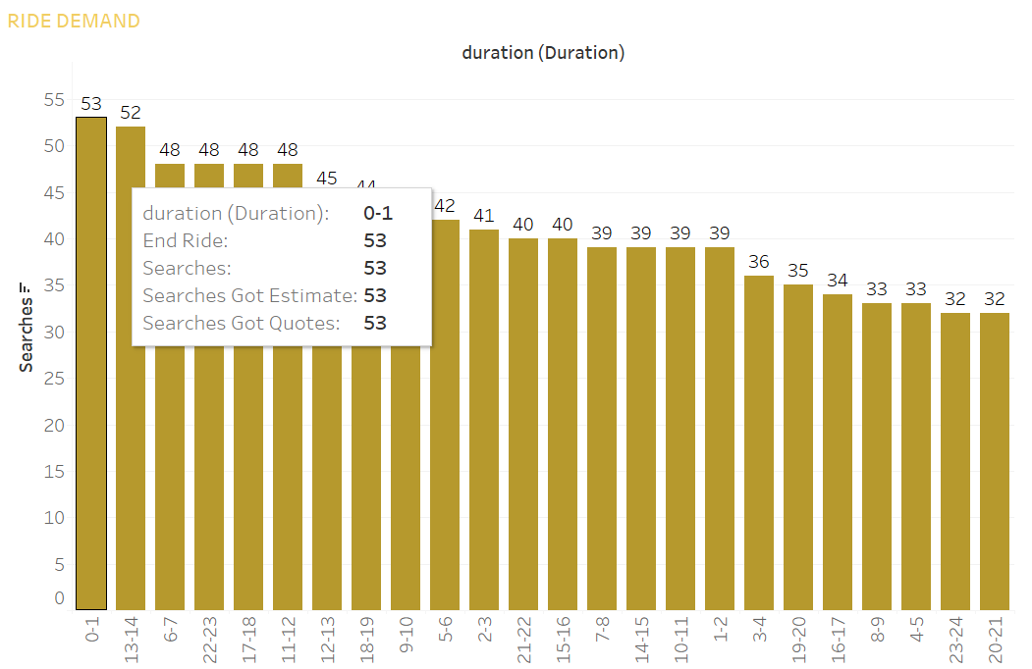
Peak Demand

Slide 7
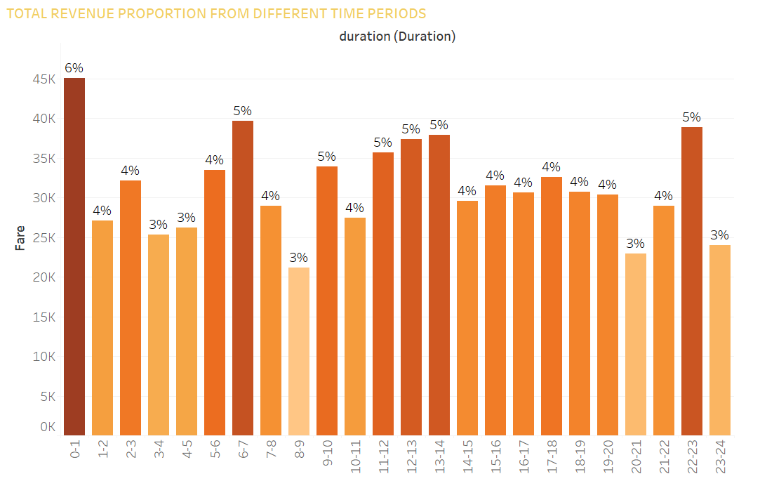
Revenue Window

Slide 8
2.Pick-Up location Performance
Top Pickup Location by Volume:
Ramanagaram and Yeshwantpur are the leading zones in terms of pick-up activity
A broad mid-tier group including zones from Sarvagnanagar to Jayanagar shows healthy ride activity from 25 to 31 trips
Lower Pickup Location By Volume
Pick-up location from Krishnarajapuram to Doddaballapur shows lower ride volumes suggesting either- ▪ Lower demand ▪ Lower app penetration ▪Insufficient driver presence
Top Revenue Zones:
Bangalore South, Yeshwantpur, Hebbal, Rajarajeshwarinagar, Ramanagaram
Key Observation:
High ride demand observed in MG Road, Whitefield, Indiranagar
Recommendation:
Deploy more vehicles and route promotions in high-performing zones for better conversion.
Launch promotions (first-ride discounts, cashback) targeted at users in these zones
Geo-targeted push notifications during peak times to increase retention

Slide 9
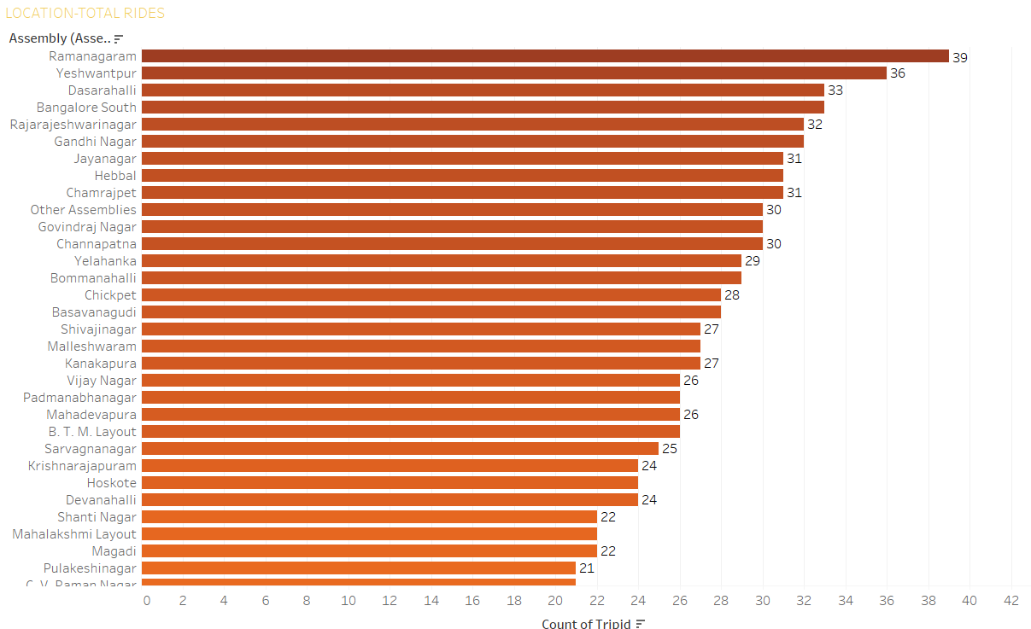
Pick-Up location Performance- No. Of Rides Basis

Slide 10
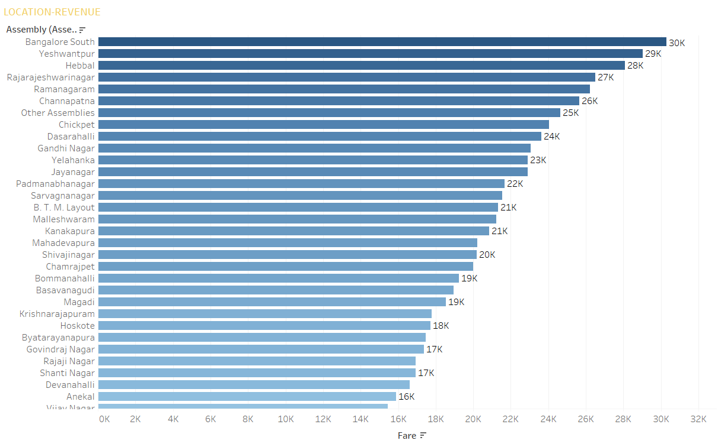
Pick-Up location Performance- Revenue Basis

Slide 11
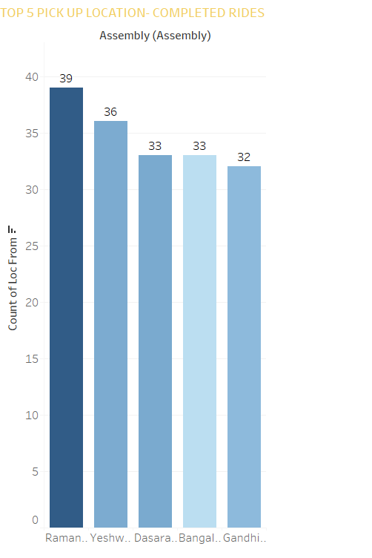
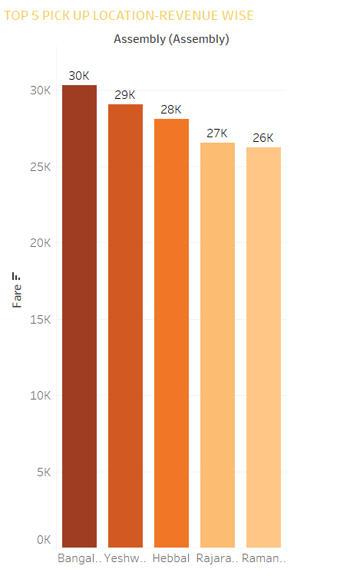
Top-5 Pick-Up location- Rides & Revenue Basis

Slide 12
3. Demand by Time Bucket
Breakdown:
Morning (6–12): 244 rides
Afternoon (12–17): 224 rides
Evening (17–22): 200 rides
Early Morning (0–6): 180 rides
Late Night (22–24): 120 rides
Opportunity: Low traffic in late night and early morning hours suggests space for safety-centric campaigns (e.g., “Ride Safe at Night”).

Slide 13
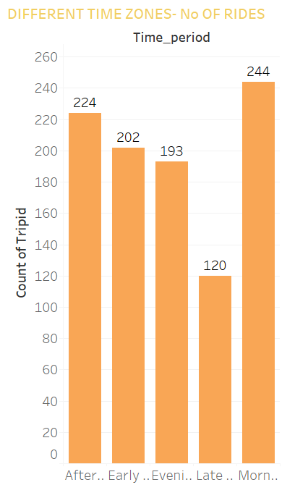
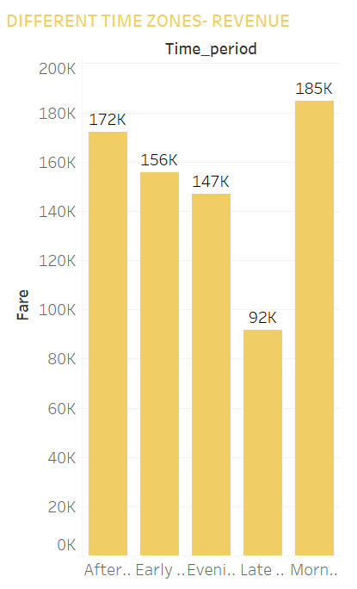
Demand by Time Bucket

Slide 14
4. Payment Preferences
PAYMENT METHOD | % TOTAL No. OF RIDES | CONTRIBUTION
CREDIT CARD | 27% | 77% DIGITAL TRANSACTION
DEBIT CARD | 25%
UPI | 25%
CASH | 24% | 24% CASH
UPI & Wallet-Based Incentives
UPI and Wallet payments dominate, but some users still prefer cash.
Key Observation:
77% of the transactions are through Digital mode.
Recommendation:
Offer ₹10–20 cashback on UPI rides to encourage digital payments
Partner with platforms like PhonePe, Paytm for co-marketing

Slide 15
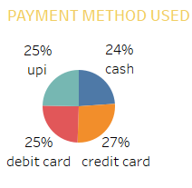
Payment Preferences

Slide 16
5. Conversion Efficiency – Ride Funnel
Completed Rides-983
Get Estimates-1,758
Total Searches-2,161
Get Quote-1,277

Slide 17
5. Conversion Efficiency – Ride Funnel
Insight:
76.89% of users who receive a quote end up completing the ride.
Business Value: Customer trust and system efficiency are strong post-quote. Focus can now shift to improving the earlier funnel (search to estimate).
Recommendation:
Run limited-time promo codes visible on the quote screen
Offer ₹20 off if booked within 30 seconds

Slide 18
Strategic Recommendation:
Demand-Driven Scheduling:
Match driver availability with high-demand hours (morning & late evening).
Promotional Campaigns: Launch midday and late-night offers to increase demand in low-performing slots.
Zone-Level Targeting:
Focus marketing and driver deployment in high-yield areas like Bangalore South and Yashwantpur.
Digital Payment Adoption:
Offer incentives to further reduce cash usage and support smoother transactions.
Seasonal & Festival Campaigns:
Use ride data to plan festival-period campaigns in high-volume zones.
Push app-only offers to drive downloads and loyalty.

Slide 19
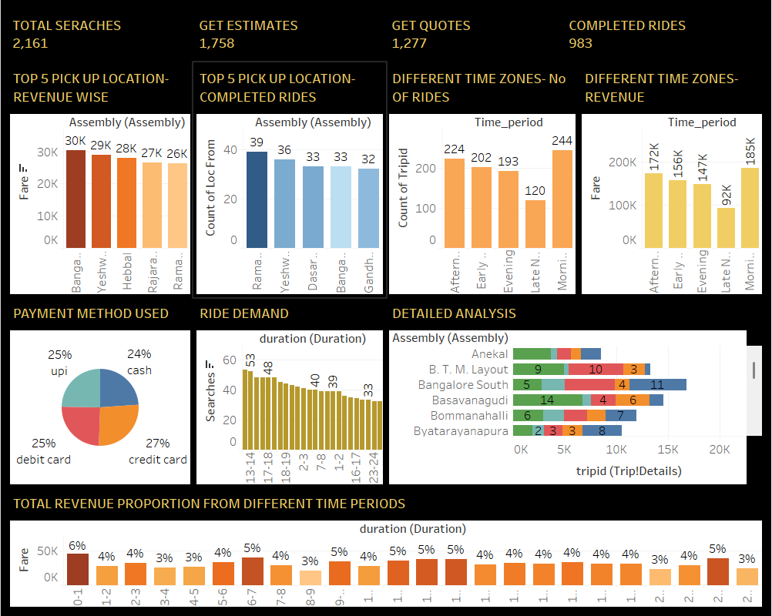
Management Dashboard:

Slide 20
Operational KPIs:
Metric | Current | Target (Next 3 Months)
Quote-to-Ride Completion | 76.89% | Maintain ≥ 99.5%
Digital Payment Share | 77% | Grow to 85%
Late-Night Ride Volume | 120 | Increase by 15%
Avg Fare per Trip (₹) | 250 | Improve by 10% via pricing
Monitoring: These KPIs can be tracked weekly through enhanced Tableau dashboards.

Slide 21
Roadmap & Nest Steps:
Next 30 Days:
Roll out time-based driver allocation
Launch promotional offers for late-night rides
Next 3 Months:
Track zone-specific performance dynamically
Expand digital payment reward program
Next 6 Months:
Integrate ML-powered pricing and demand forecasting models
Reduce wait times through predictive driver dispatch

Slide 22
Conclusion & Strategic Impact:
Conclusion:
The data reveals strong growth opportunities by aligning resources with demand patterns, optimizing digital engagement, and focusing on high-performing zones.
Expected Outcomes:
Higher ride conversion
Increased profitability per km
Reduced cancellations
Better customer satisfaction

Slide 23
Thank You

